Slide 1
Accounting Principles
Thirteenth Edition
Weygandt ● Kimmel ● Kieso
Chapter 5
Accounting for Merchandising Operations
This slide deck contains animations. Please disable animations if they cause issues with your device.

Slide 2
Chapter Outline
  Learning Objectives
L O 1 Describe merchandising operations and inventory systems.
L O 2 Record purchases under a perpetual inventory system.
L O 3 Record sales under a perpetual inventory system.
L O 4 Apply the steps in the accounting cycle to a merchandising company.
L O 5 Prepare a multiple-step income statement and a comprehensive income statement.

Slide 3
Merchandising Operations and Inventory Systems
Merchandising companies that sell directly to consumers are called retailers.
Merchandising companies that sell to retailers are known as wholesalers.
The primary source of revenues is referred to as sales revenue or sales.

Slide 4
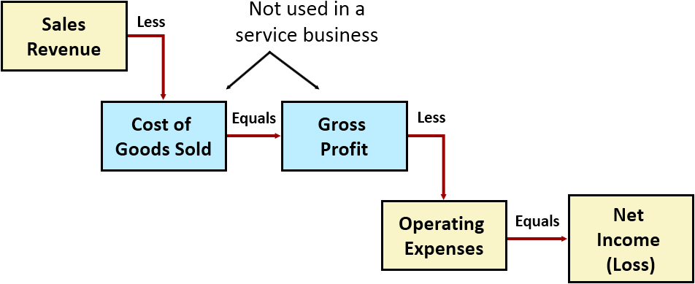
Merchandising Operations
Income Measurement
Cost of goods sold is the total cost of merchandise sold during the period.

Slide 5
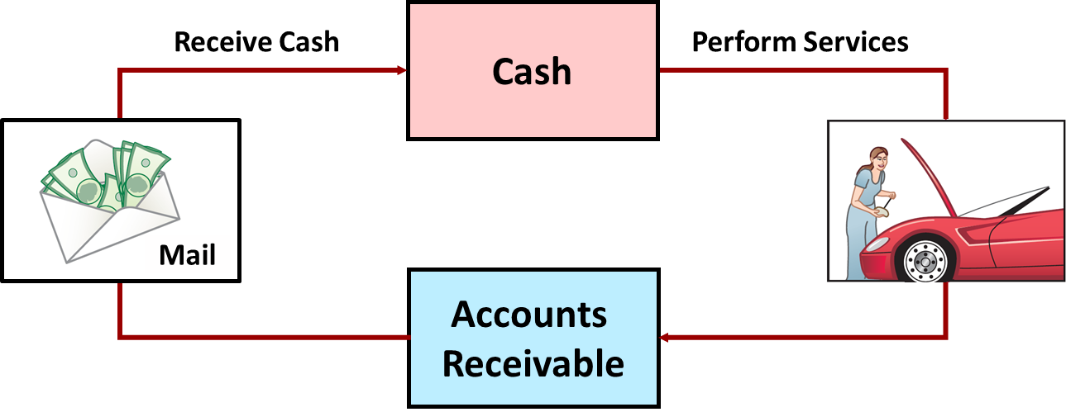
Operating Cycles (1 of 2)
Service Company

Slide 6
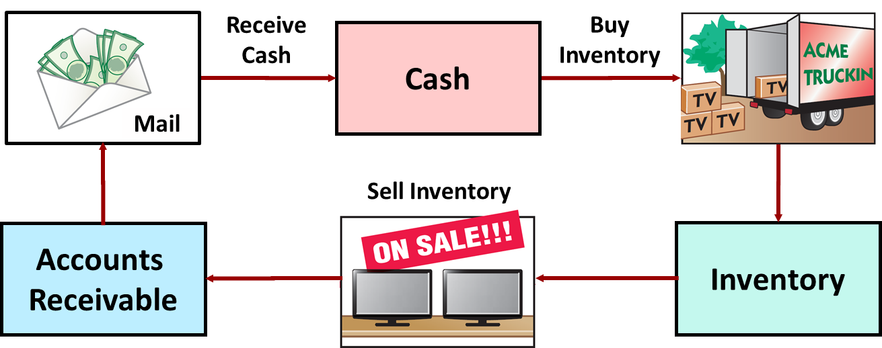
Operating Cycles (2 of 2)
Merchandising Company
Ordinarily is longer than that of a service company.

Slide 7
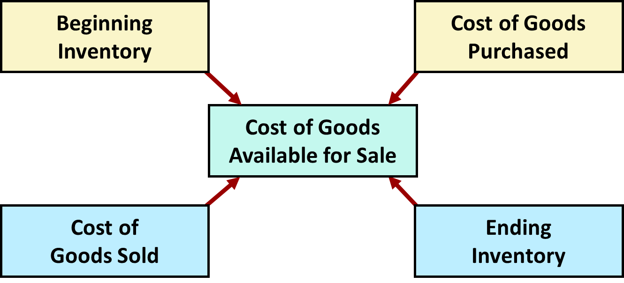
Flow of Costs (1 of 4)
Companies use a perpetual or a periodic inventory system.

Slide 8
Flow of Costs (2 of 4)
    Perpetual System
    Maintain detailed records of cost of each inventory purchase and sale
    Records continuously show inventory that should be on hand for every item
    Company determines cost of goods sold each time a sale occurs

Slide 9
Flow of Costs (3 of 4)
    Periodic System
    Do not keep detailed records of the goods on hand
    Cost of goods sold determined by count at the end of the accounting period
    Calculation of Cost of Goods Sold:
Beginning inventory | $ 100,000
Add: Purchases, net | 800,000
Goods available for sale | 900,000
Less: Ending inventory | 125,000
Cost of goods sold | $ 775,000

Slide 10
Flow of Costs (4 of 4)
    Advantages of the Perpetual System
    Traditionally used for merchandise with high unit values
    Shows quantity and cost of inventory that should be on hand at any time
    Provides better control over inventories than a periodic system

Slide 11
Recording Purchases Perpetual System (1 of 3)
    Made using cash or credit (on account)
    Normally record when goods are received from seller
    Purchase invoice should support each credit purchase

Slide 12
Merchandising Journals Recording Process
Title/Journal Case | Periodic |  | Perpetual
 | Buyer/Purchase | Seller/Sales | Buyer/Purchase | Seller/Sales
Purchase/Sells | Purchase Dr. Accounts Payable Cr. | Accounts Receivable Dr. Sales Revenue | Inventory Dr. Accounts Payable Cr. | Accounts Receivable Dr. Sales Revenue Cr. Cost of goods sold Dr. Inventory Cr.
Purchase and Sales Returns | Accounts Payable Dr. Purchase Ret & All. Cr. | Sales Ret & All. Dr. Accounts Rece. Cr. | Accounts Payable Dr. Inventory Cr. | Sales Ret & All. Dr. Accounts Rece. Cr. Inventory Dr. Cost of goods sold Cr.
FOB Shipping Point(Buyer) FOB Destination (Seller) | Fright in Dr. Cash Cr. | Fright Out exp Dr. Cash Cr. | Inventory Dr. Cash Cr. | Fright Out exp Dr. Cash Cr.
Payment Received and Paid with Discount 2/10, Net 30 (2% Discount if payment is made within 10 days) | Accounts Payable Dr. Cash Cr. Purchase Disc. Cr. | Cash Dr. Sales Disc. Dr. Accounts Rece. Cr. | Accounts Payable Dr. Cash Cr. Inventory Cr. | Cash Dr. Sales Disc. Dr. Accounts Rece. Cr.

Slide 13
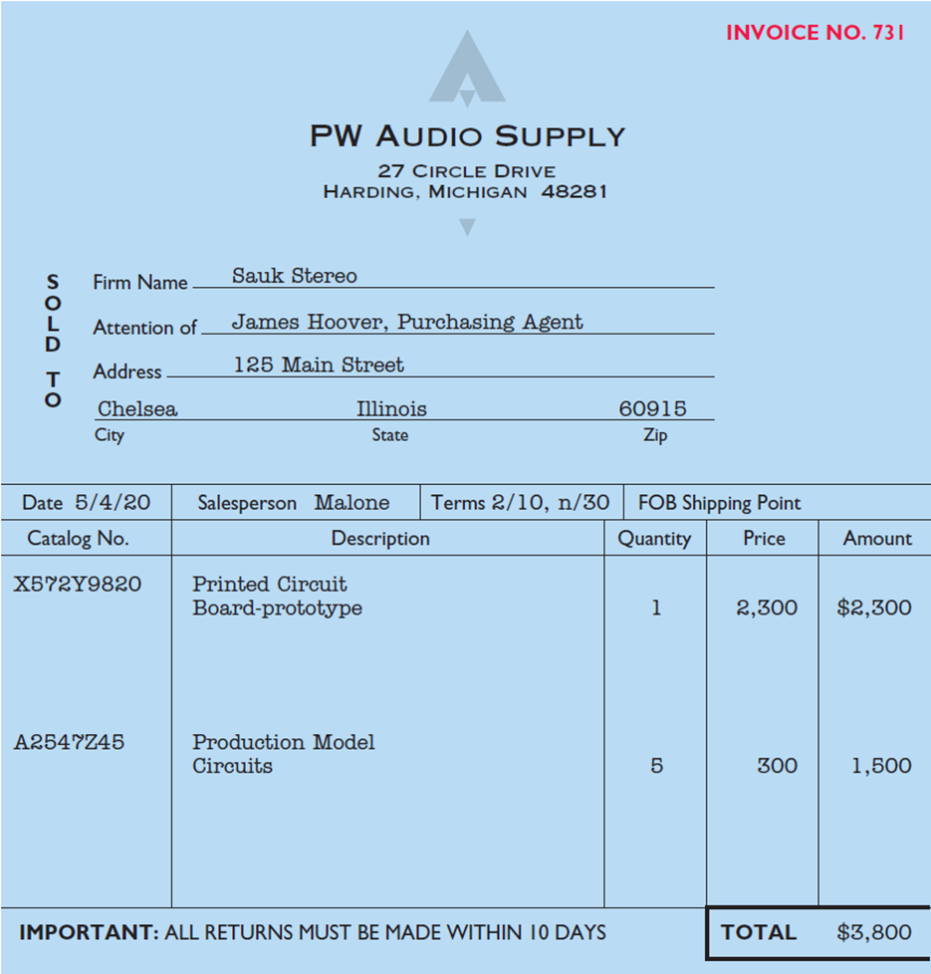
Recording Purchases Perpetual System (2 of 3)
Purchase invoice should support each credit purchase

Slide 14
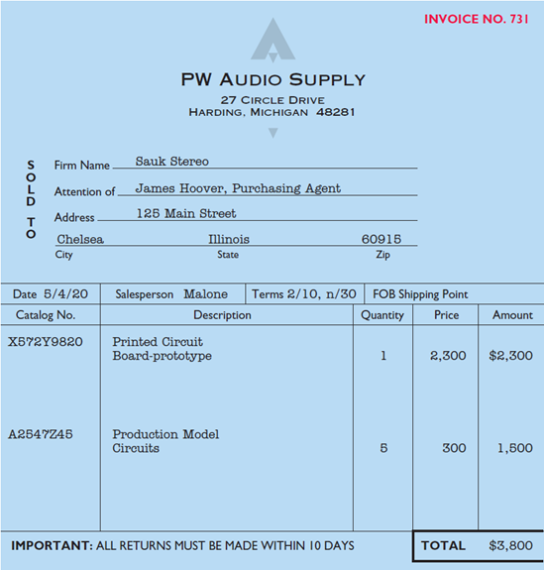
Recording Purchases Perpetual System (3 of 3)
Illustration: Sauk Stereo (the buyer) uses as a purchase invoice the sales invoice prepared by PW Audio Supply (the seller). Prepare the journal entry for Sauk Stereo for the invoice from PW Audio Supply.
May 4
Inventory
3,800
Accounts Payable
(To record goods purchased on account from P W Audio Supply)
3,800

Slide 15
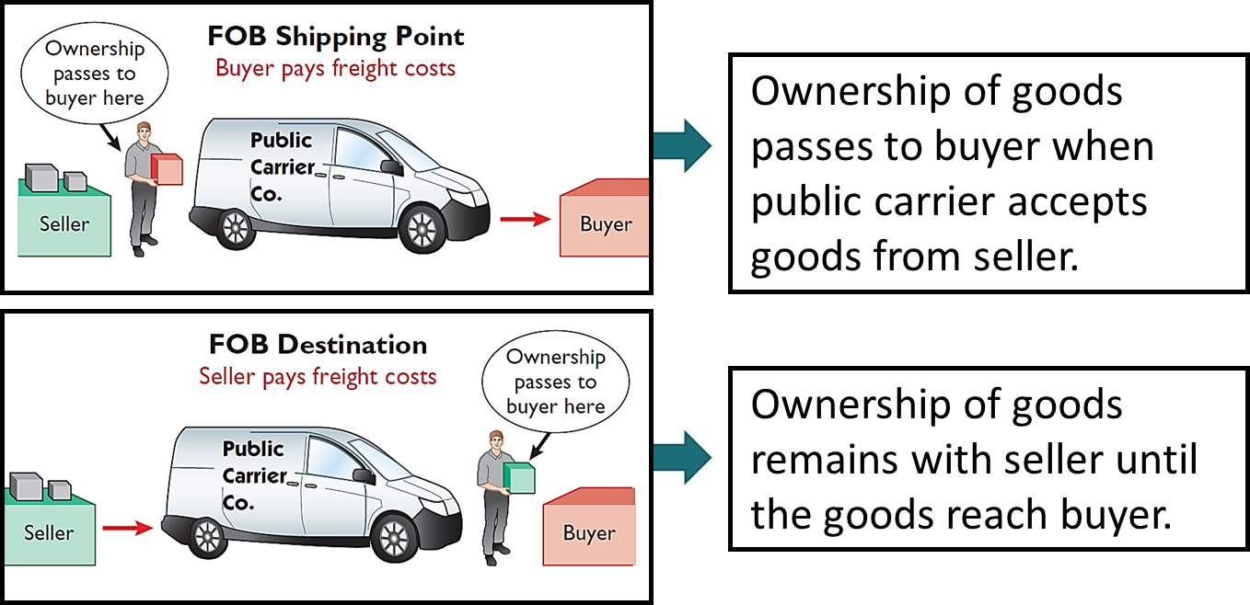
Freight Costs (1 of 2)
Freight costs incurred by the seller are an operating expense.

Slide 16
Freight Costs (2 of 2)
Illustration: If Sauk Stereo (the buyer) pays Public Carrier Co. $150 for freight charges on May 6, the entry on Sauk Stereo’s books is:
May 6
Inventory
150
Cash
150
If the freight terms on the invoice in Illustration 5.6 had required PW Audio Supply (the seller) to pay the freight charges, the entry by PW Audio Supply would be:
May 4
Freight-Out (Delivery Expense)
150
Cash
150

Slide 17
Purchase Returns and Allowances (1 of 4)
Purchaser may be dissatisfied because goods are damaged or defective, of inferior quality, or do not meet purchaser’s specifications.
Purchase Return
Purchaser may return goods to seller for credit if sale was made on credit, or for a cash refund if purchase was for cash.
Purchase Allowance
Purchaser may choose to keep merchandise if seller will grant an allowance (deduction) from purchase price.

Slide 18
Purchase Returns and Allowances (2 of 4)
Illustration: Assume that Sauk Stereo returned goods costing $300 to PW Audio Supply on May 8.
May 8
Accounts Payable
300
Inventory
(To record return of goods purchased from P W Audio Supply)
300

Slide 19
Purchase Discounts (1 of 5)
    Credit terms may permit buyer to claim a cash discount for prompt payment. Example: Credit terms 2/10, n/30.
    Advantages:
    Purchaser saves money, and
    Seller shortens operating cycle by converting accounts receivable into cash earlier

Slide 20
Purchase Discounts (2 of 5)
2/10, n/30
2% discount if paid within 10 days, otherwise net amount due within 30 days.
1/10 EOM
1% discount if paid within first 10 days of next month
n/10 E O M
Net amount due within the first 10 days of the next month

Slide 21
Purchase Discounts (3 of 5)
Illustration: Assume Sauk Stereo pays the balance due of $3,500 (gross invoice price of $3,800 less purchase returns and allowances of $300) on May 14, the last day of the discount period. Prepare the journal entry Sauk Stereo makes on May 14 to record the payment.
May 14
Accounts Payable
3,500
Cash
3,430
Inventory
70
(Discount = $3,500 × 2% = $70)
(To record payment within discount period)

Slide 22
Purchase Discounts (4 of 5)
Illustration: If Sauk Stereo failed to take the discount, and instead made full payment of $3,500 on June 3, the journal entry would be:
June 3
Accounts Payable
3,500
Cash
3,500

Slide 23
Purchase Discounts (5 of 5)
Should discounts be taken when offered?
Discount of 2% on $3,500 | $70.00
$3,500 loan at 10% for 20 days | 19.18
Savings by taking the discount | $50.82
Example: 2% for the use of $3,500 for 20 days = Annual rate of 36.5% (2% × 365/20)

Slide 24
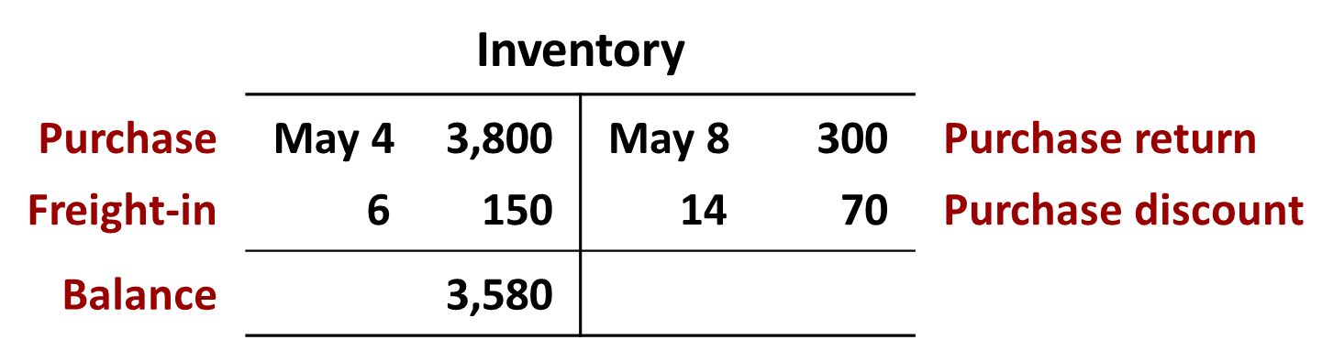
Summary of Purchasing Transactions

Slide 25
Do It! 2: Purchase Transactions
On September 5, De La Hoya Company buys merchandise on account from Junot Diaz Company. The purchase price of the goods paid by De La Hoya is $1,500, and the cost to Diaz Company was $800. On September 8, De La Hoya returns defective goods with a selling price of $200. Record the transactions on the books of De La Hoya Company.
Sept. 5
Inventory
1,500
Accounts Payable
(To record goods purchased on account)
1,500
8
Accounts Payable
200
Inventory
(To record return of defective goods)
200

Slide 26
Recording Sales Perpetual System (1 of 3)
    Made using cash or credit (on account)
    Sales revenue, like service revenue, is recorded when performance obligation is satisfied
    Performance obligation is satisfied when goods are transferred from seller to buyer
    Sales invoice should support each credit sale

Slide 27
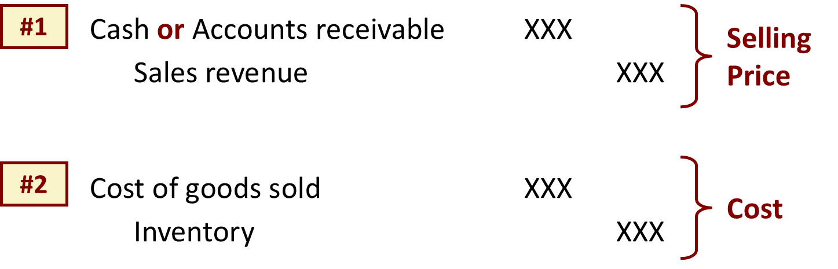
Recording Sales Perpetual System (2 of 3)
Journal Entries to Record a Sale

Slide 28
Recording Sales Perpetual System (3 of 3)
Illustration: PW Audio Supply records its May 4 sale of $3,800 to Sauk Stereo (Illustration 5.6) as follows (assume merchandise cost PW Audio Supply $2,400).
May 4
Accounts Receivable
3,800
Sales Revenue
(To record credit sale to Sauk Stereo per invoice #731)
3,800
4
Cost of Goods Sold
2,400
Inventory
(To record cost of merchandise sold on invoice #731 to Sauk Stereo)
2,400

Slide 29
Sales Returns and Allowances (1 of 5)
    “Flip side” of purchase returns and allowances
    Contra-revenue account to Sales Revenue (debit)
    Sales not reduced (debited) because:
      Would obscure importance of sales returns and allowances as a percentage of sales
      Could distort comparisons between total sales in different accounting periods.

Slide 30
Sales Returns and Allowances (2 of 5)
Illustration: Prepare the entry PW Audio Supply would make to record the credit for returned goods that had a $300 selling price (assume a $140 cost). Assume the goods were not defective.
May 8
Sales Returns and Allowances
300
Accounts Receivable
(To record credit granted to Sauk Stereo for returned goods)
300
8
Inventory
140
Cost of Goods Sold
(To record cost of goods returned)
140

Slide 31
Sales Returns and Allowances (3 of 5)
Illustration: Assume the returned goods were defective and had a scrap value of $50, P W Audio would make the following entries.
May 8
Sales Returns and Allowances
300
Accounts Receivable
(To record credit granted to Sauk Stereo for returned goods)
300
8
Inventory
50
Cost of Goods Sold
(To record fair value of goods returned)
50

Slide 32
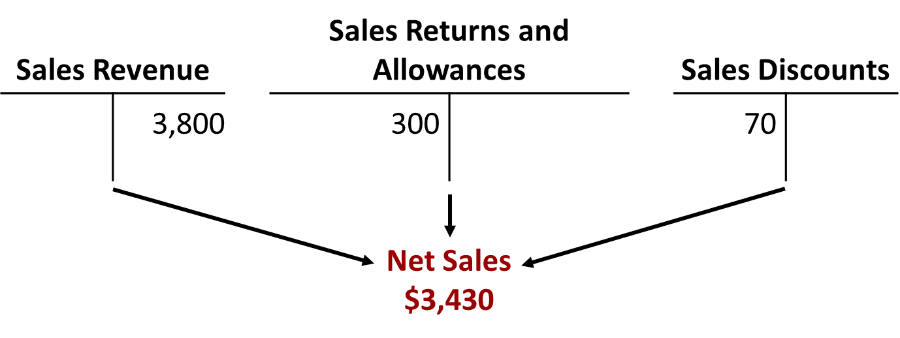
Sales Discounts (1 of 2)
    Offered to customers to promote prompt payment of balance due
    Contra-revenue account (debit) to Sales Revenue

Slide 33
Sales Discounts (2 of 2)
Illustration: Assume Sauk Stereo pays the balance due of $3,500 (gross invoice price of $3,800 less purchase returns and allowances of $300) on May 14, the last day of the discount period. Prepare the journal entry PW Audio Supply makes to record the receipt on May 14.
Cash
3,430
Sales Discounts
70
Accounts Receivable
(To record collection within 2/10, n/30 discount period from Sauk Stereo)
3,500
[($3,800 − $300) × 2%]

Slide 34
Do It! 3: Sales Transactions (1 of 2)
On September 5, De La Hoya Company buys merchandise on account from Junot Diaz Company. The selling price of the goods is $1,500, and the cost to Diaz Company was $800. On September 8, De La Hoya returns defective goods with a selling price of $200 and a fair value of $30. Record the transactions on the books of Junot Diaz Company.
Sept. 5
Accounts Receivable
1,500
Sales Revenue
(To record credit sale)
1,500
5
Cost of Goods Sold
800
Inventory
(To record cost of goods sold on account)
800

Slide 35
Do It! 3: Sales Transactions (2 of 2)
On September 5, De La Hoya Company buys merchandise on account from Junot Diaz Company. The selling price of the goods is $1,500, and the cost to Diaz Company was $800. On September 8, De La Hoya returns defective goods with a selling price of $200 and a fair value of $30. Record the transactions on the books of Junot Diaz Company.
Sept. 8
Sales Returns and Allowances
200
Accounts Receivable
(To record credit granted for receipt of returned goods)
200
8
Inventory
30
Cost of Goods Sold
(To record fair value of goods returned)
30

Slide 36
The Accounting Cycle for a Merchandising Company
    Adjusting Entries
    Generally same as a service company
    One additional adjustment to make records agree with actual inventory on hand
    Involves adjusting Inventory and Cost of Goods Sold

Slide 37
Merchandising Journals Recording Process
Title/Journal Case | Periodic |  | Perpetual
 | Buyer/Purchase | Seller/Sales | Buyer/Purchase | Seller/Sales
Purchase/Sells | Purchase Dr. Accounts Payable Cr. | Accounts Receivable Dr. Sales Revenue | Inventory Dr. Accounts Payable Cr. | Accounts Receivable Dr. Sales Revenue Cr. Cost of goods sold Dr. Inventory Cr.
Purchase and Sales Returns | Accounts Payable Dr. Purchase Ret & All. Cr. | Sales Ret & All. Dr. Accounts Rece. Cr. | Accounts Payable Dr. Inventory Cr. | Sales Ret & All. Dr. Accounts Rece. Cr. Inventory Dr. Cost of goods sold Cr.
FOB Shipping Point (Buyer) FOB Destination (Seller) | Fright in Dr. Cash Cr. | Fright Out exp Dr. Cash Cr. | Inventory Dr. Cash Cr. | Fright Out exp Dr. Cash Cr.
Payment Received and Paid with Discount 2/10, Net 30 (2% Discount if payment is made within 10 days) | Accounts Payable Dr. Cash Cr. Purchase Disc. Cr. | Cash Dr. Sales Disc. Dr. Accounts Rece. Cr. | Accounts Payable Dr. Cash Cr. Inventory Cr. | Cash Dr. Sales Disc. Dr. Accounts Rece. Cr.

Slide 38
Adjusting Entries
Illustration: Suppose that PW Audio Supply has an unadjusted balance of $40,500 in Inventory. Through a physical count, PW Audio Supply determines that its actual merchandise inventory at December 31 is $40,000. The company would make an adjusting entry as follows.
Cost of Goods Sold
500
Inventory ($40,500 − $40,000)
(To adjust inventory to physical count)
500

Slide 39
Multiple-Step and Comprehensive Income Statements
    Shows several steps in determining net income
    Two steps relate to principal operating activities
    Distinguishes between operating and non-operating activities
    Highlights intermediate components of income and shows subgroupings of expenses.

Slide 40
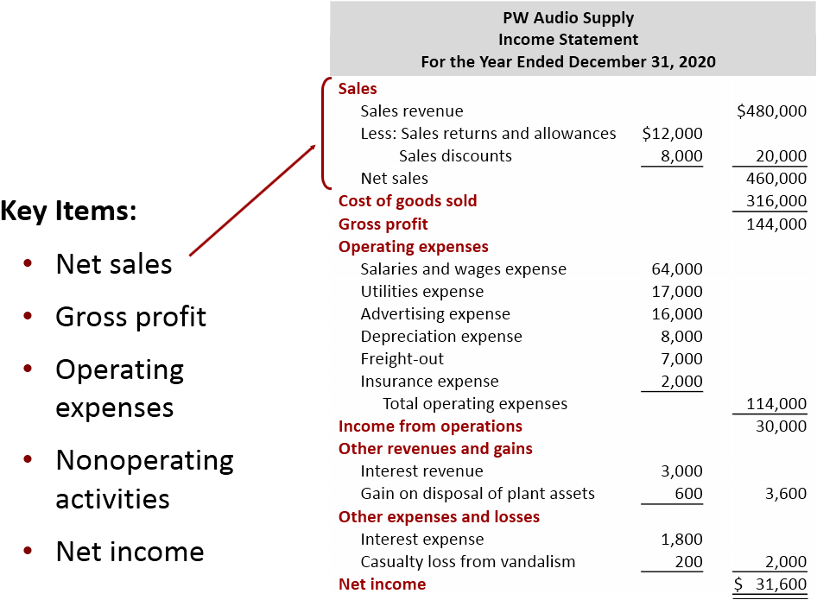
Multiple-Step (1 of 2)

Slide 41
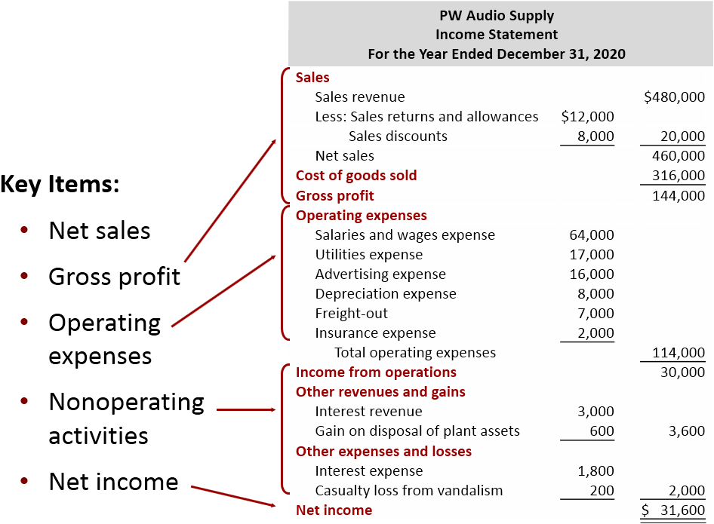
Multiple-Step (2 of 2)

Slide 42
Nonoperating Activities
Various revenues and expenses and gains and losses that are unrelated to company’s main line of operations.
Other Revenues and Gains
Interest revenue from notes receivable and marketable securities.
Dividend revenue from investments in common stock.
Rent revenue from subleasing a portion of the store.
Gain from the sale of property, plant, and equipment.
Other Expenses and Losses
Interest expense on notes and loans payable.
Casualty losses from recurring causes, such as vandalism and accidents.
Loss from the sale or abandonment of property, plant, and equipment.
Loss from strikes by employees and suppliers.

Slide 43
Single-Step Income Statement
    Subtract total expenses from total revenues in one step
    Two reasons for using single-step format:
      Company does not realize any profit until total revenues exceed total expenses
      Format is simpler and easier to read

Slide 44
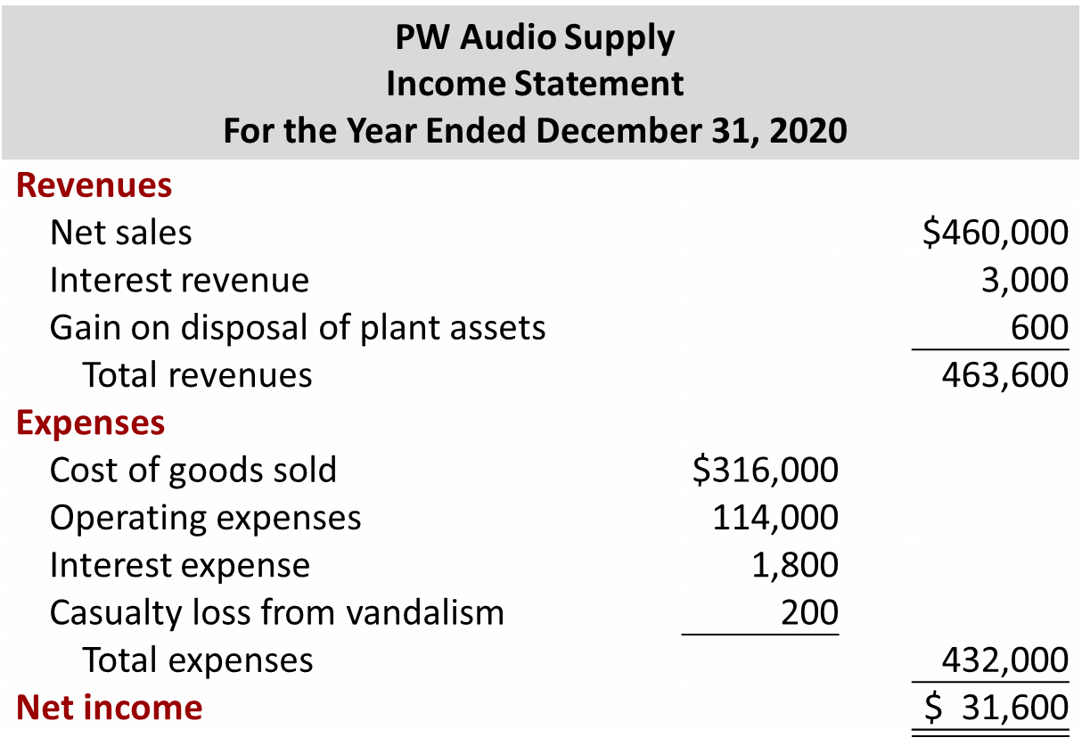
Single-Step

Slide 45
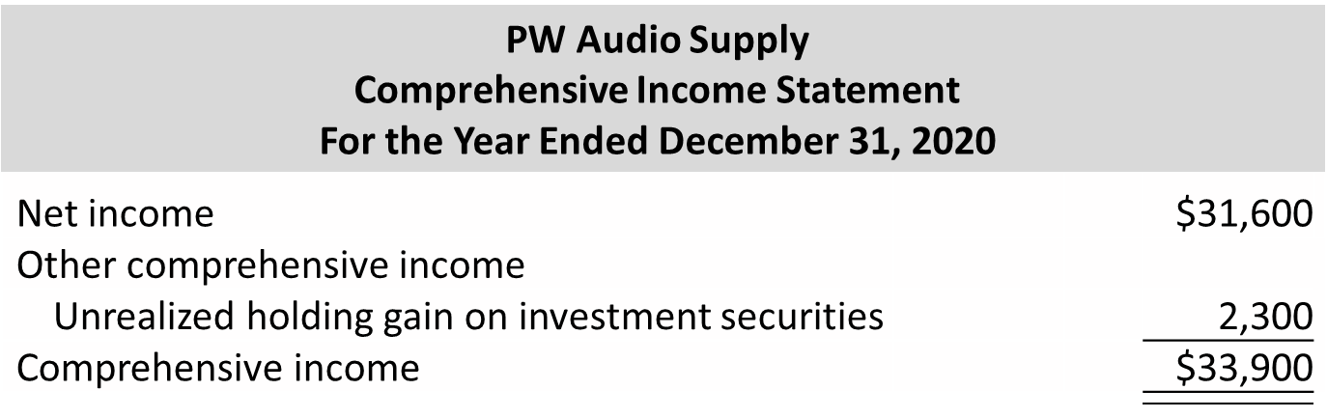
Comprehensive Income Statement
Items excluded from net income but included in comprehensive income are either reported in either:
Combined statement of net income and comprehensive income
Separate comprehensive income statement

Slide 46
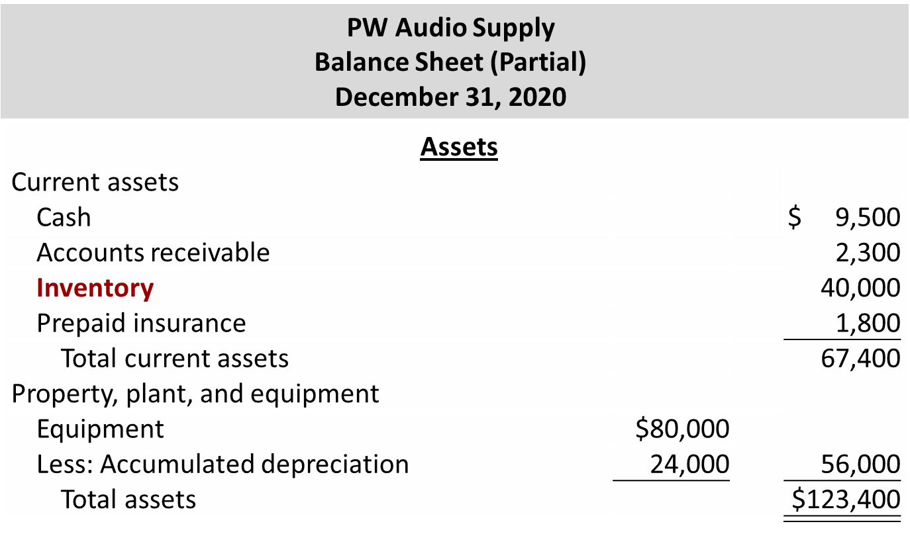
Classified Balance Sheet

Slide 47
Do It! 5: Multiple-Step Income Statement (1 of 3)
The following information is available for Art Center for the year ended December 31, 2020.
Other revenues and gains | $ 8,000 | Sales revenue | $462,000
Other expenses and losses | 3,000 | Operating expenses | 187,000
Cost of goods sold | 147,000 | Sales discounts | 20,000
Other comprehensive loss | 10,000
Prepare a multiple-step income statement and comprehensive income statement for Art Center.

Slide 48
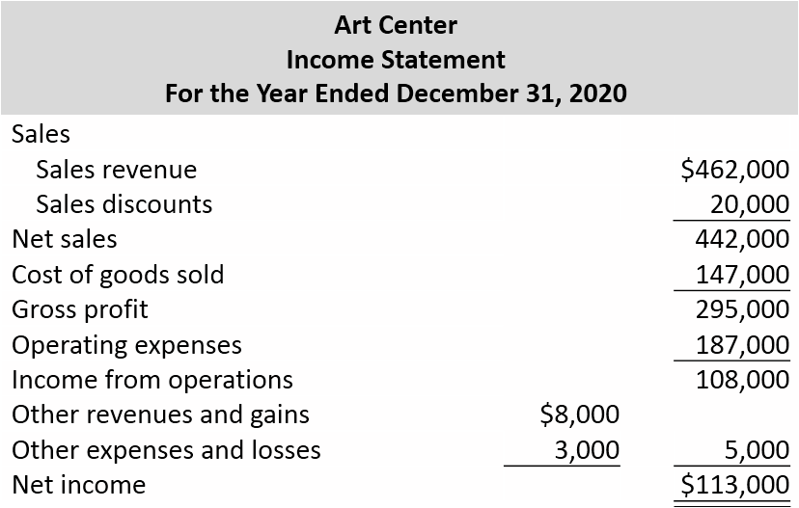
Do It! 5: Multiple-Step Income Statement (2 of 3)

Slide 49
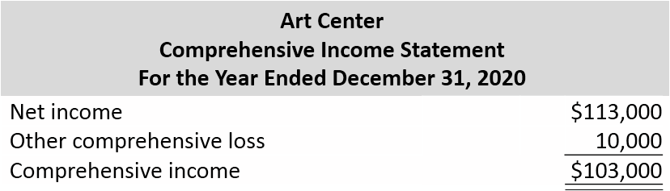
Do It! 5: Multiple-Step Income Statement (3 of 3)

Slide 50
Appendix 5B: Periodic Inventory System (1 of 2)
Determining Cost of Goods Sold Under a Periodic System
    No running account of changes in inventory
    Ending inventory determined by physical count
    Cost of goods sold not determined until end of period
    Different accounts used for purchases, freight costs, returns, and discounts

Slide 51
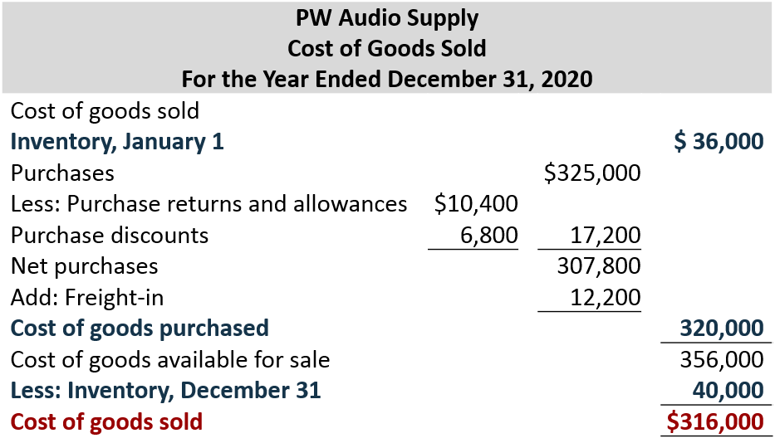
Appendix 5B: Periodic Inventory System (2 of 2)

Slide 52
Recording Merchandise Transactions
    Record revenues when sales are made
    Cost of merchandise sold not recorded on date of sale
    Physical inventory count at end of period determines:
      cost of merchandise on hand and
      cost of merchandise sold during the period
    Purchases recorded in Purchases account
    Purchase returns and allowances, Purchase discounts, and Freight costs are recorded in separate accounts

Slide 53
Recording Purchases of Merchandise (1 of 4)
Illustration: On the basis of the sales invoice (Illustration 5.6) and receipt of the merchandise ordered from P W Audio Supply, Sauk Stereo records the $3,800 purchase as follows.
May 4
Purchases
3,800
Accounts Payable
(To record goods purchased on account from P W Audio Supply)
3,800

Slide 54
Recording Purchases of Merchandise (2 of 4)
Freight Costs
Illustration: If Sauk Stereo pays Public Carrier Co. $150 for freight charges on its purchase from P W Audio Supply on May 6, the entry on Sauk Stereo’s books is:
May 6
Freight-In (Transportation-In)
150
Cash
(To record payment of freight on goods purchased)
150

Slide 55
Recording Purchases of Merchandise (3 of 4)
Purchase Returns and Allowances
Illustration: Sauk Stereo returns goods costing $300 to P W Audio Supply and prepares the following entry to recognize the return.
May 8
Accounts Payable
300
Purchase Returns and Allowances
(To record return of goods purchased from P W Audio Supply)
300

Slide 56
Recording Purchases of Merchandise (4 of 4)
Purchase Discounts
Illustration: On May 14, Sauk Stereo pays the balance due on account to PW Audio Supply, taking the 2% cash discount allowed by PW Audio Supply for payment within 10 days. Sauk Stereo records the payment and discount as follows.
May 14
Accounts Payable ($3,800 − $300)
3,500
Purchase Discounts ($3,500 × .02)
70
Cash
(To record payment within the discount period)
3,430

Slide 57
Recording Sales of Merchandise (1 of 3)
Illustration: The seller, PW Audio Supply, records the sale of $3,800 of merchandise to Sauk Stereo on May 4 (sales invoice No. 731, Illustration 5.6) as follows.
May 4
Accounts Receivable
3,800
Sales Revenue
(To record credit sales per invoice #731 to Sauk Stereo)
3,800
No entry is recorded for cost of goods sold at time of sale under a periodic system.

Slide 58
Recording Sales of Merchandise (2 of 3)
Sales Returns and Allowances
Illustration: To record the returned goods received from Sauk Stereo on May 8, PW Audio Supply records the $300 sales return as follows.
May 8
Sales Returns and Allowance
300
Accounts Receivable
(To record credit granted to Sauk Stereo for returned goods)
300

Slide 59
Recording Sales of Merchandise (3 of 3)
Sales Discounts
Illustration: On May 14, PW Audio Supply receives payment of $3,430 on account from Sauk Stereo. PW Audio Supply honors the 2% cash discount and records the payment of Sauk Stereo’s account receivable in full as follows.
May 14
Cash
3,430
Sales Discounts ($3,500 × .02)
70
Accounts Receivable ($3,800 − $300)
(To record collection within 2/10, n/30 discount period from Sauk Stereo)
3,500

